Slide 1


Lesson 18 At the airport
UNIT 4

Slide 2
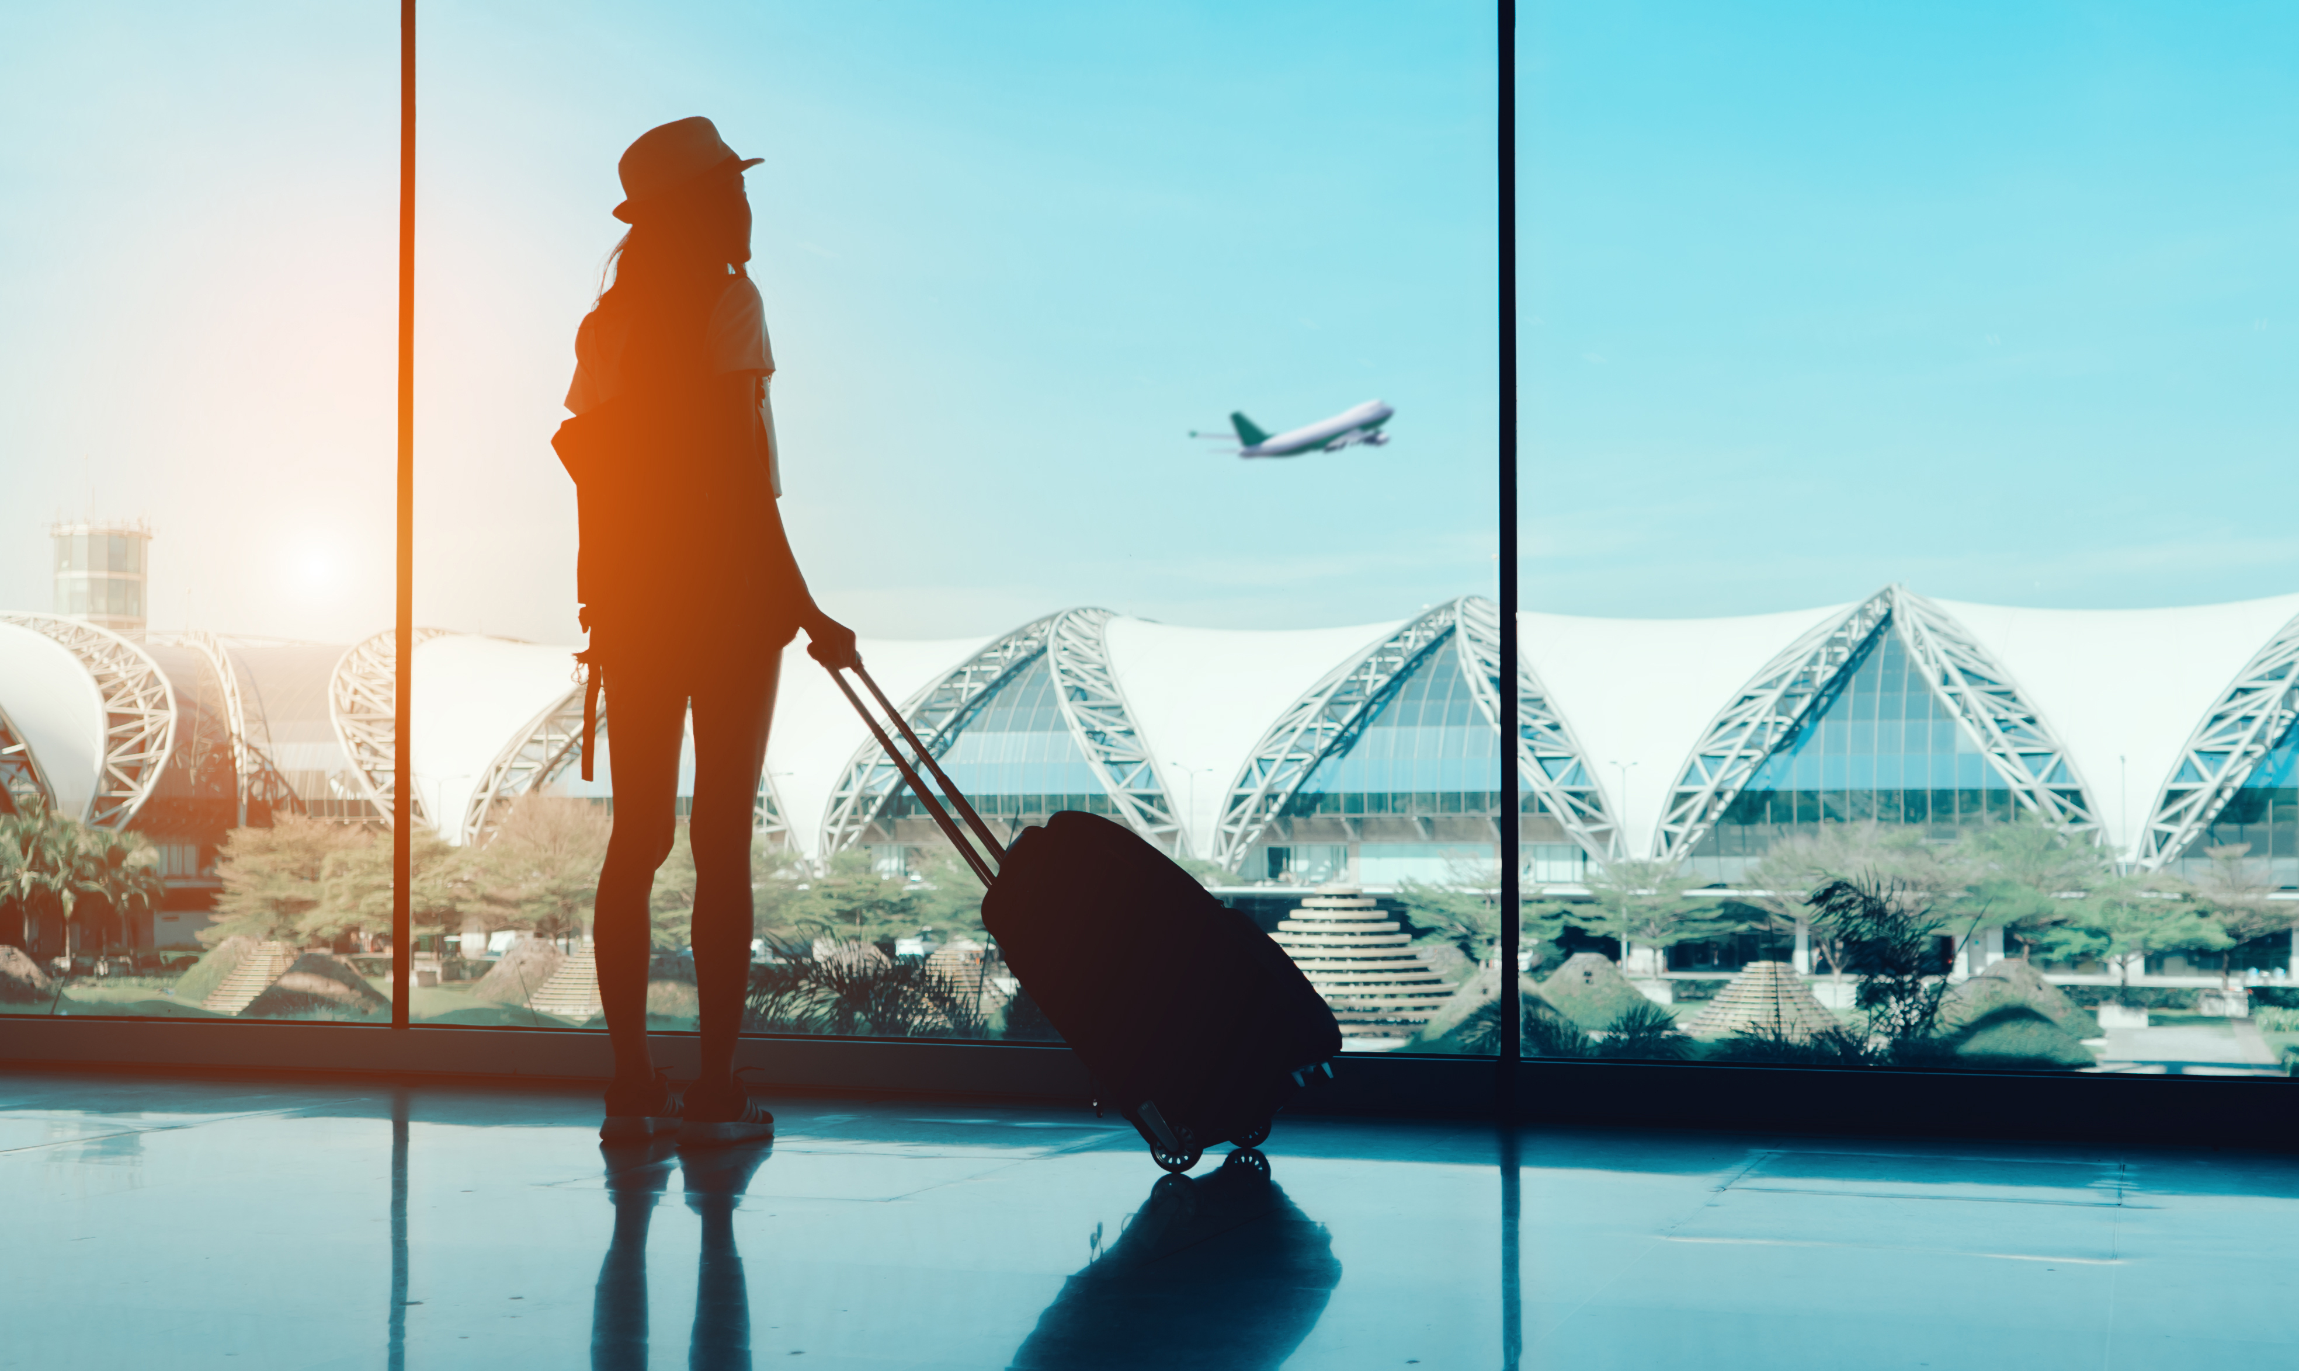
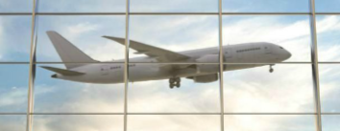
Have you ever travelled by plane? Have you ever been at the airport?
Write down as many words connected with travelling by planes. Work in pairs.

Slide 3
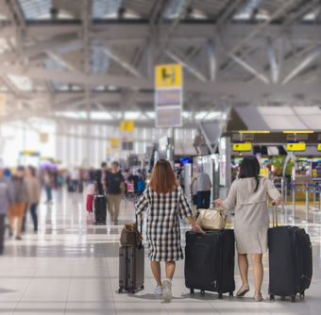
Translate.
prtljaga
ručna prtljaga
šalter za prijavu putnika
vaga
ukrcati se na avion
karta za ukrcaj u zrakoplov
sjedalo
carinski službenik
službenik osiguranja
čekaonica u zrakoplovnoj luci
najava leta
luggage
hand luggage
check-in desk
scales
board a plane
boarding card
seat
customs officer
security (officer)
departure lounge
announcement

Slide 4
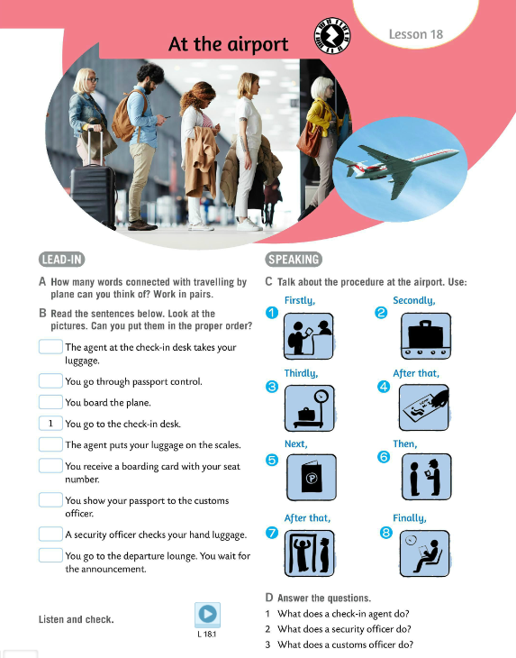
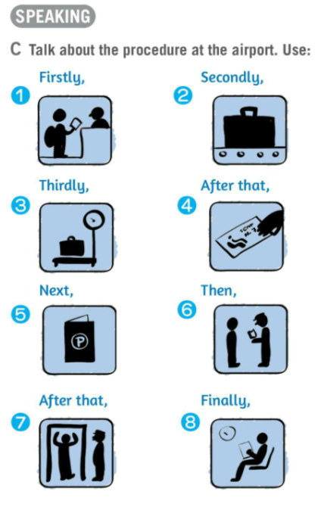
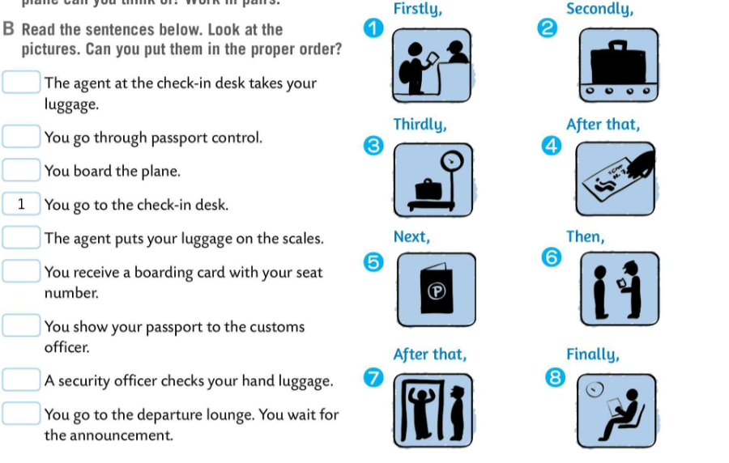

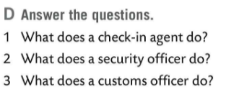
Do Task B. Put the pictures in the proper order.
Listen and check.
2
Talk about the procedure at the airport in Task C. Use the following words: firstly, secondly, thirdly, after that, next, the, after that, and finally.
5
9
3
4
6
Answer the questions in Task D.
7
8
Check.
1 A check-in agent takes your luggage, weights it on a scale and gives you a boarding pass.
2 A security officer checks your hand luggage.
3 A customs officer checks documents.

Slide 5
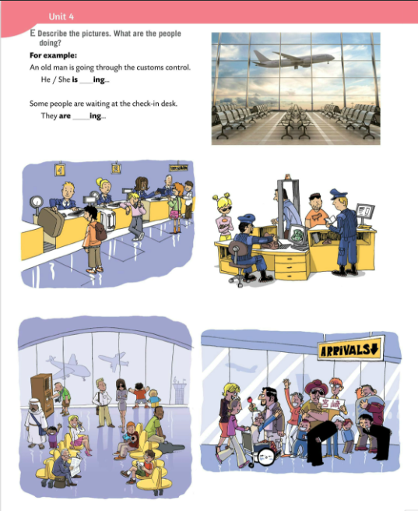
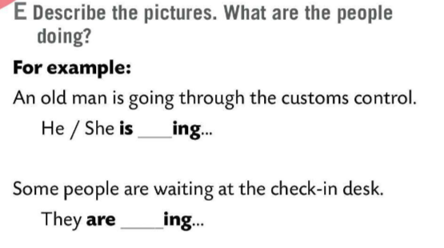
Describe the pictures in Task E. What are the people doing?
Example:
An old man is going through the customs control.
He/She is ________ing
Some people are waiting at the check-in desk.
They are __________ing

Slide 6
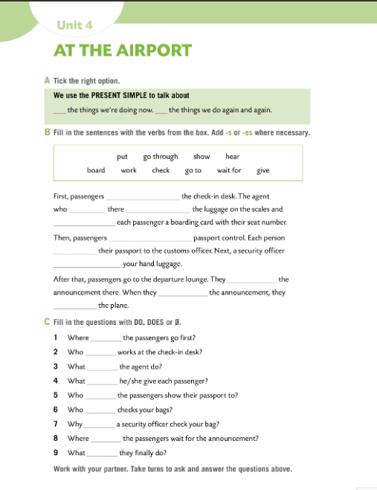

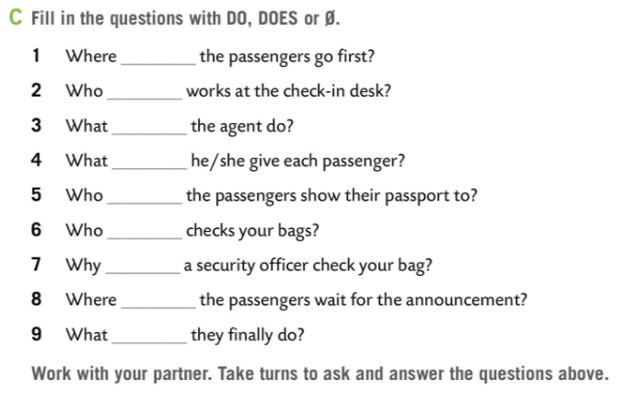
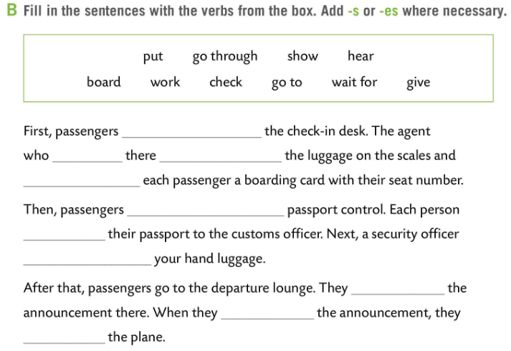
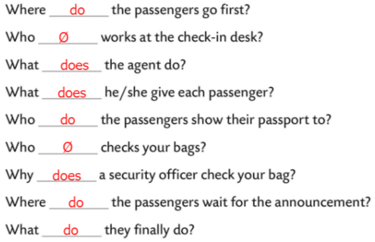
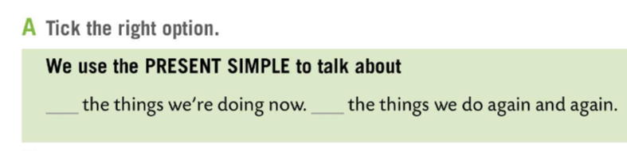
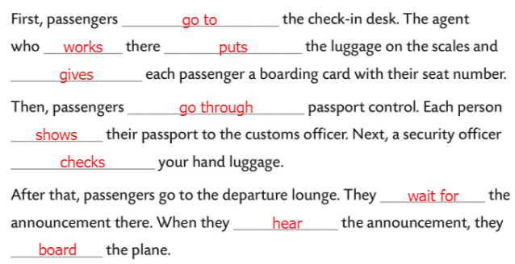

Workbook page 94.
Tick the right option in Task A.
Check.
Fill in the sentences in Task B with verbs from the box. Add –s or –es where necessary.
Check.
Fill in the questions in Task C.
Check.

Slide 7
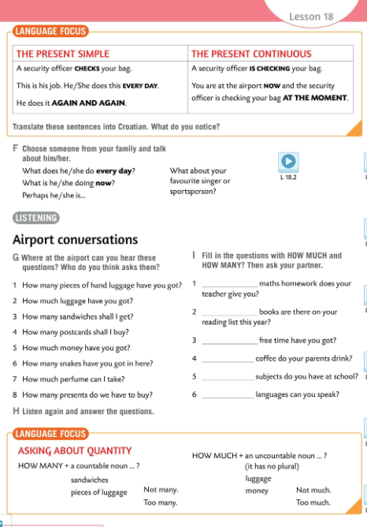
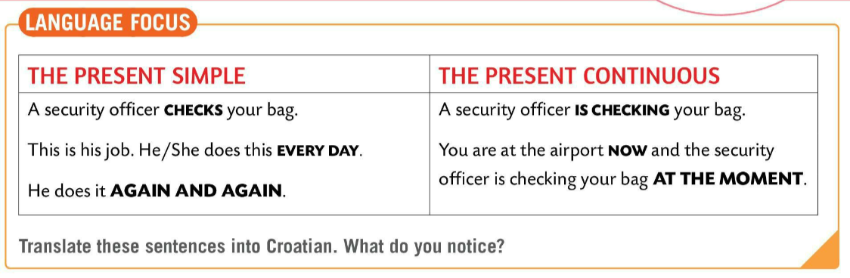
Compare the Present Simple and the Present Continuous.
Translate the sentences into Croatian.
What do you notice?
LANGUAGE FOCUS
PRESENT SIMPLE
He/She does it EVERY DAY, AGAIN AND AGAIN.
PRESENT CONTINOUS
He/She is doing it NOW, AT THE MOMENT.
A security officer CHECKS your bag.
– Službenik osiguranja provjerava torbe.
A security officer IS CHECKING your bag.
– Službenik osiguranja provjerava tvoju torbu.

Slide 8
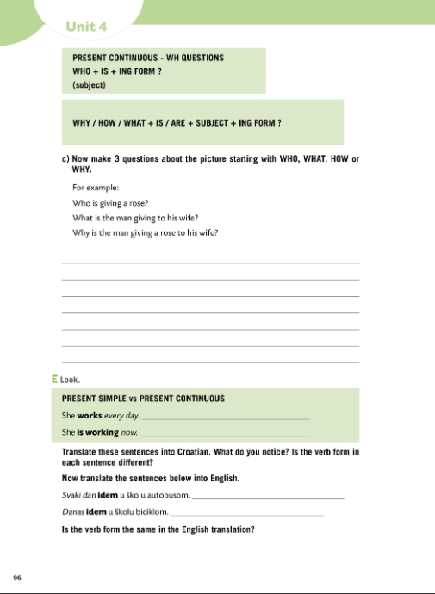
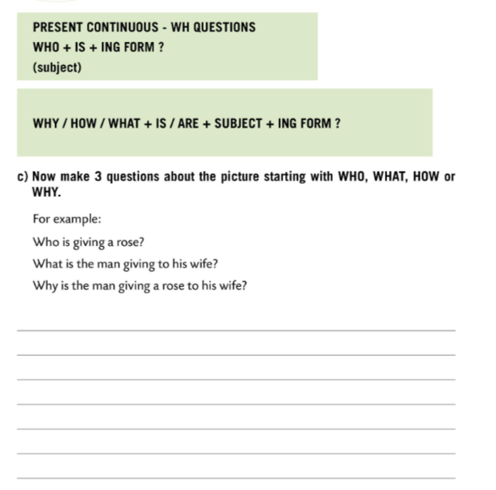
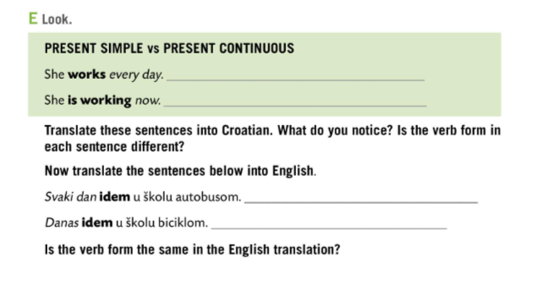
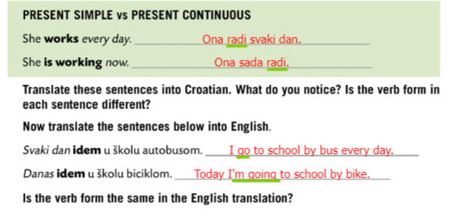
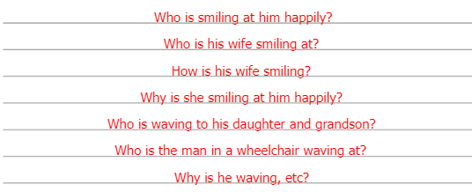
Workbook page 96.
Make three questions about the picture.
Start with WHO, WHAT, HOW or WHY.
Check.
Do Task E. Fill in the gaps. Translate the sentences into Croatian.
Is the verb form in each sentence different?
Check.

Slide 9
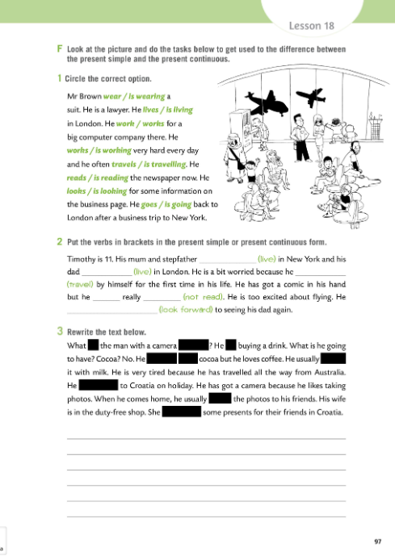
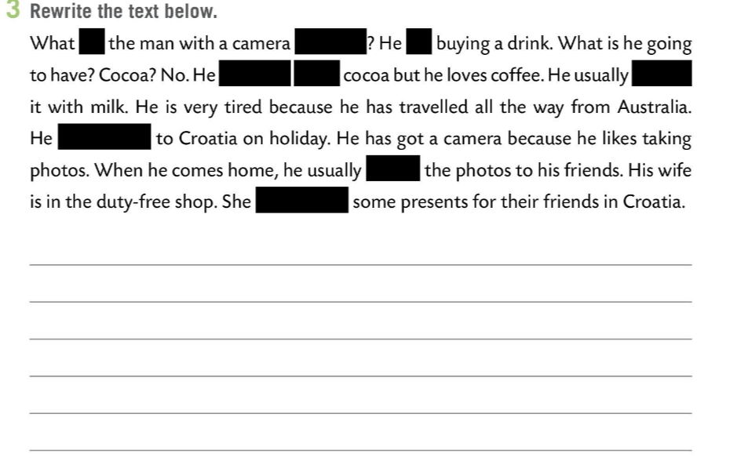
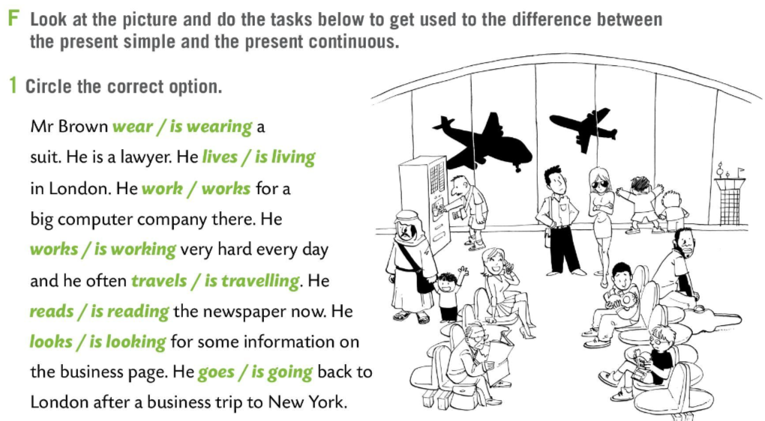
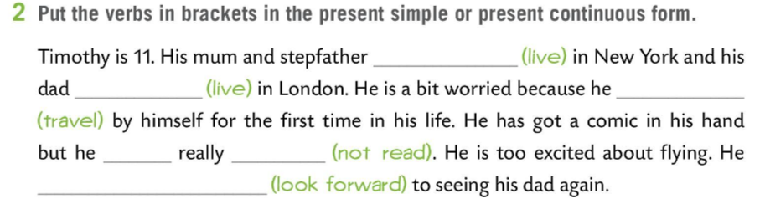
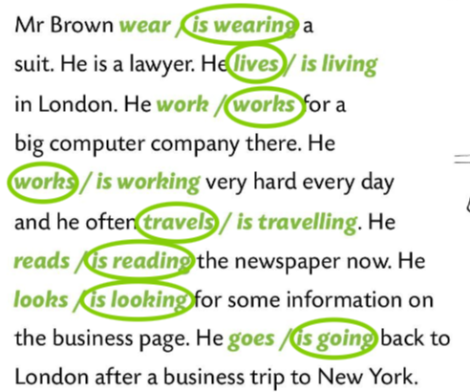
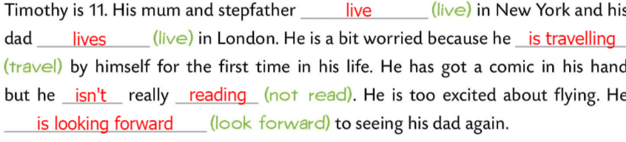
Workbook page 97.
Look at the picture and do the tasks. Use the present simple and the present continuous.
Circle the correct option in Task 1.
Check.
Put the verbs in brackets in the present simple or present continuous form.
Check.
Rewrite the text in Task 3.

Slide 10
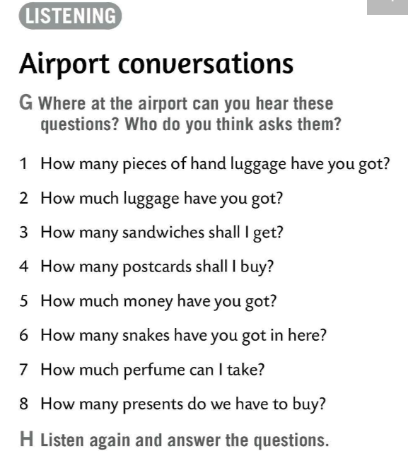
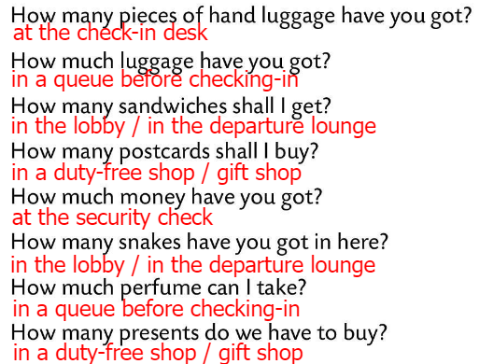
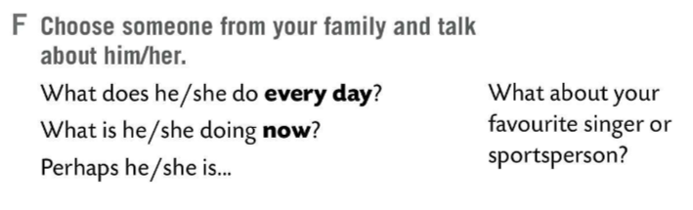
Choose someone from your family and talk about him/her.
Use sentences from Task F.
Where at the airport can you hear questions in Task G?
Who do you think asks them?
Listen to the dialogues.
1. Two, a bag and a laptop.
2. 40 kg.
3. Three sandwiches.
4. Three.
5. Up to 90 ml.
6. Two
7. 5 pounds.
8. Three
Listen again and answer the questions in your notebook.
Check.

Slide 11
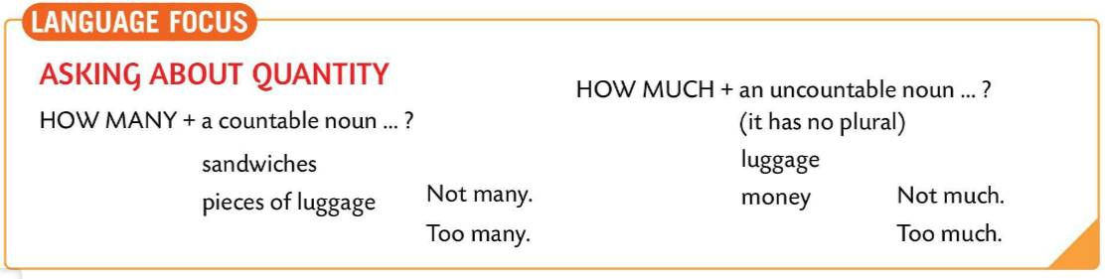
LANGUAGE FOCUS
We use HOW MANY with countable nouns.
How many sandwiches shall I get? Not many.
We use HOW MUCH with an uncountable noun (a noun that has no plural).
How much juice would you like?

Slide 12
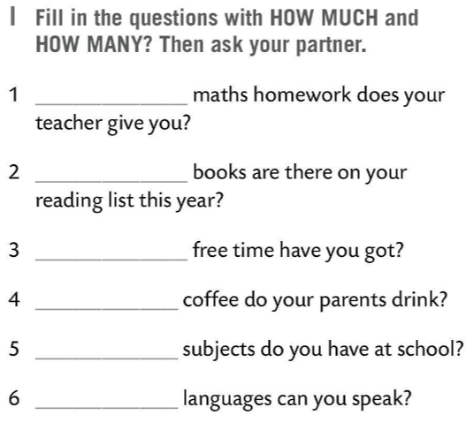
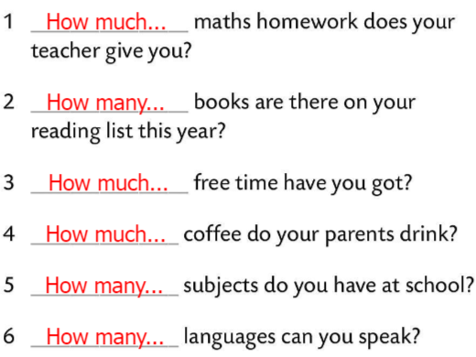
Fill in the questions in Task I.
Use HOW MUCH and HOW MANY.
Ask your partner.
Check.

Slide 13
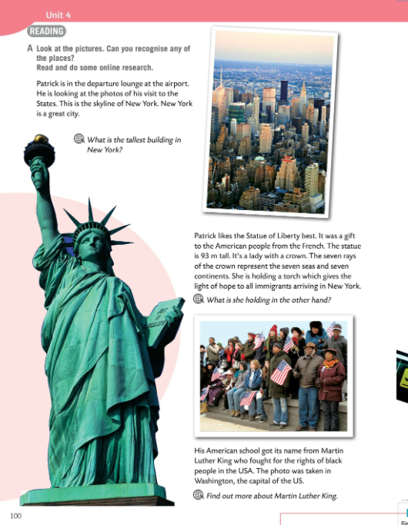
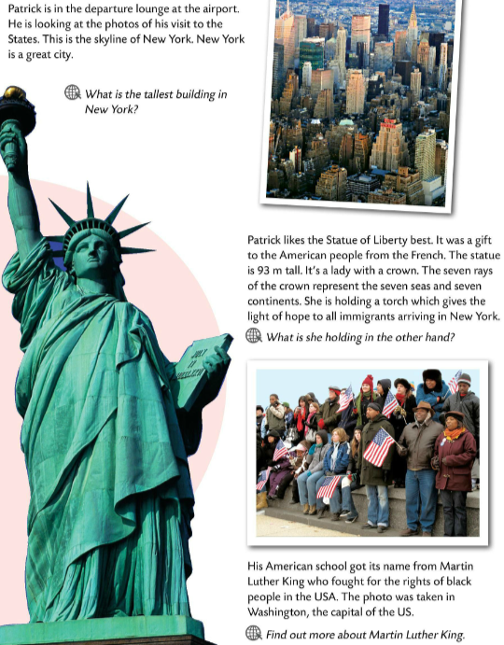
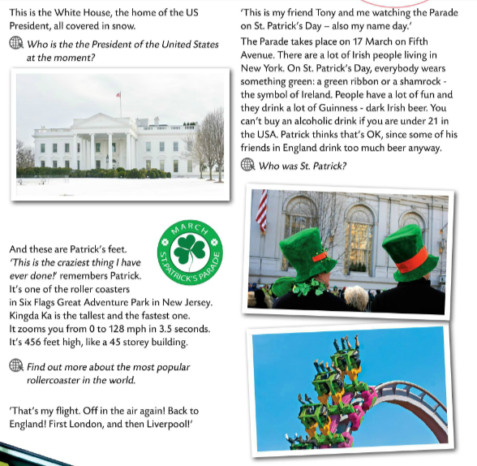
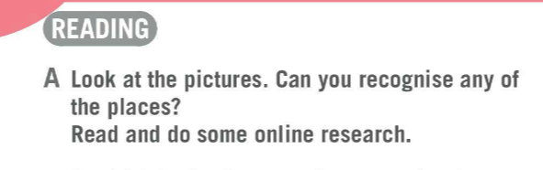
Look at the pictures in Task A. Can you recognise any of the places?
Read and do some online research.

Slide 14
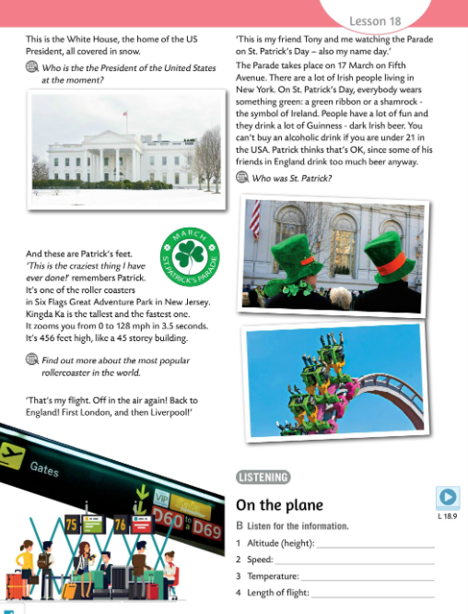
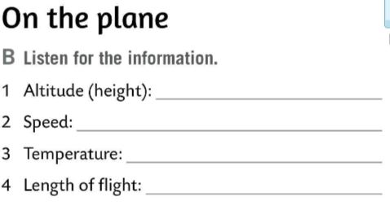
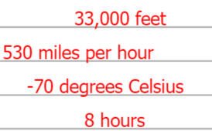
Listen to the recording and answer the questions in Task B.
Check.

Slide 15
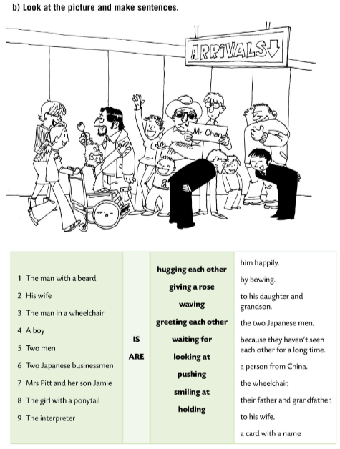
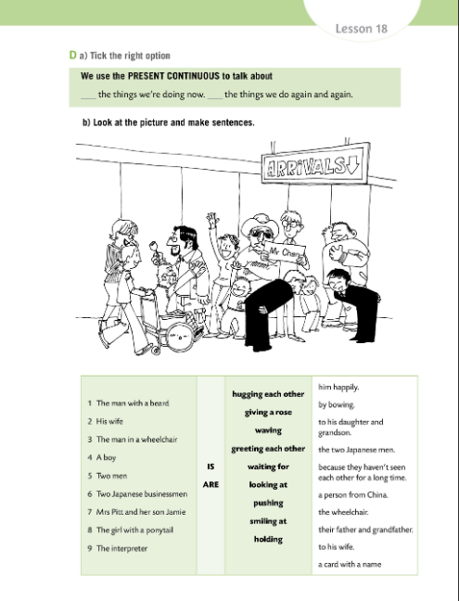
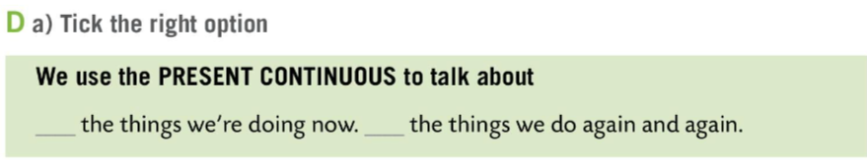
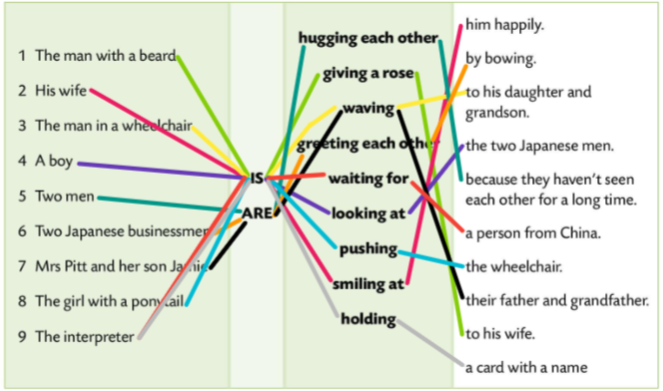
Workbook page 95.
Tick the right option in Task D.
Check.
Look at the picture and make sentences.
Check.

Slide 16
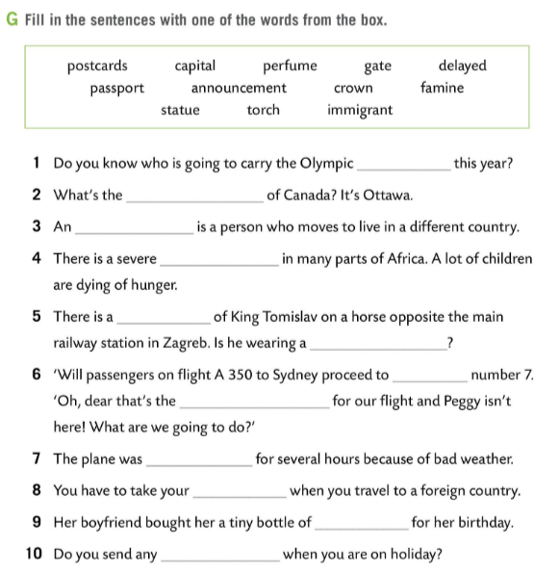
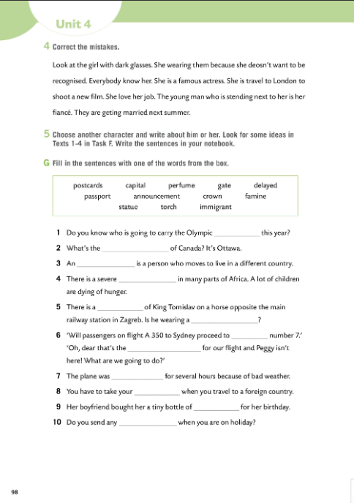
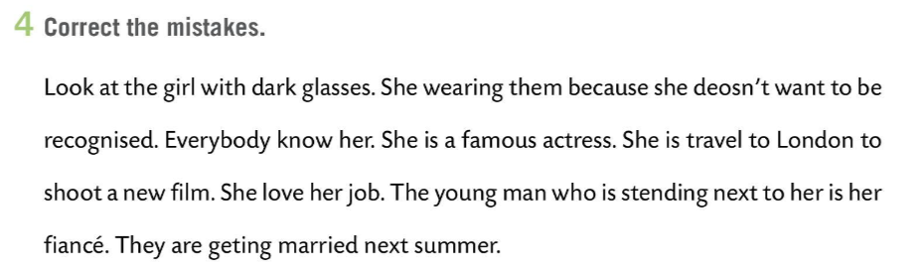
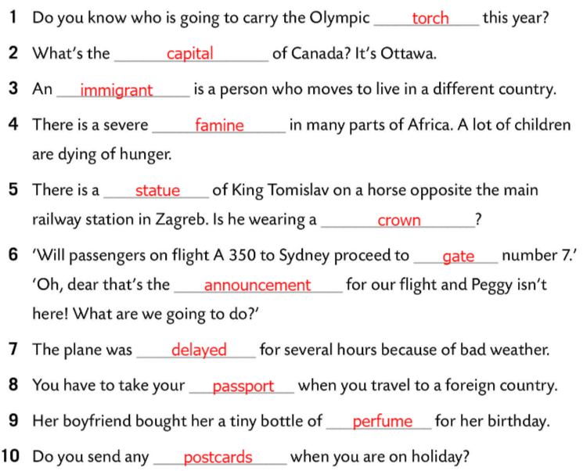
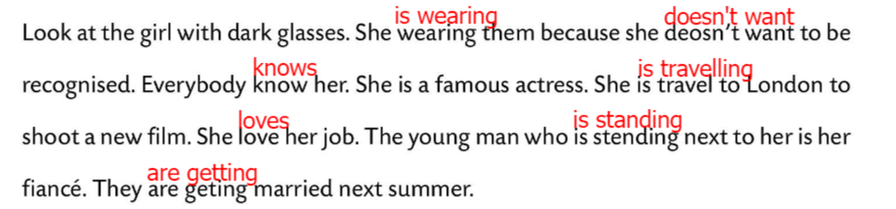
Workbook page 98.
Correct the mistakes.
Check.
Choose another character and write about him or her. Look for some ideas in Texts 1-4 in Task F.
Fill in the sentences in Task G with one of the words from the box.
Check.

